Slide 1

Golden Pegasus
Seoul National University, Mobile Computing and Its Applications - Fall 2019
Team 2
Helping you stay productive, using your mobile context
Rachel Gan, Young Woong Jun, Sigrid Marita Kvamme, Jin Yeong Kim, Seung Woo Jo
Notes:
“Pegasus was represented as a goodhearted, gentle creature, somewhat naive but always eager to help”

Slide 2
Project Deadline: Dec. 9 Midnight
• Make sure all the project related materials and pushed to the git repo.
• Source code, design images, documents, presentation slides.
• Do not commit / push anything to the git repo after the
project deadline.
• Push your final presentation slides before the deadline. Upload it to etl as well.
Final Presentation
• Demonstration of your application (Must!)
• Suggest a couple of common use case scenarios and demonstrate the applications for those scenarios.
Project overview
Motivation
Proposed idea
Novelty
Technical details
Libraries and tools used
System architecture overview
Technical challenges faced
Solution approaches
Evaluation results (if any)
Project management
• Scope of the project
• What were added and removed from the original plan and revised plan during the midterm presentation.• Timeline
• What was done and when (e.g., weekly breakdown will be nice)• Roles and contributions
• Who did what• Lessons learnt

Slide 3
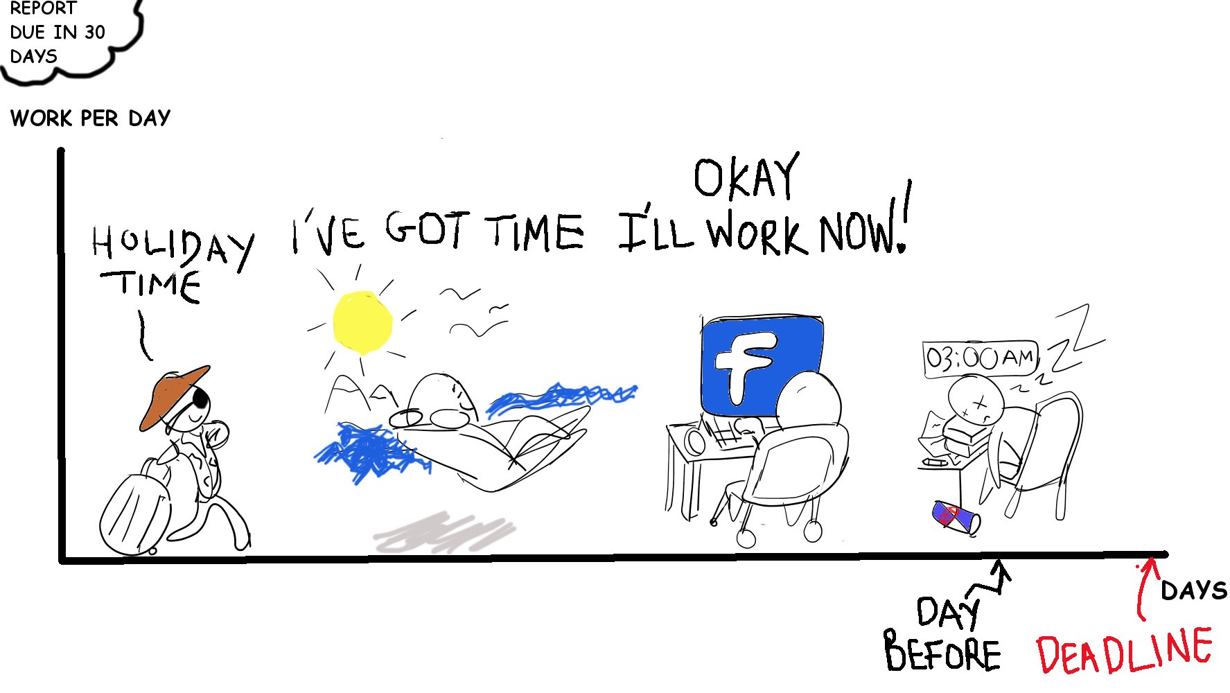
Project Idea Interactive Productivity Manager
Target Audience
Students or workers who have problems meeting deadlines
Procrastinators and people who get distracted easily
Goal
Prevent users from procrastinating and help them to increase their productivity while staying happy

Slide 4

Final Deliverable & Success Criteria
Todo List & Homework Mode
Stable homework mode that keeps track of time while the mode is on.
Send notification and fire the alarm at proper time.
Accurate detection of user motions ( shaking and walking )
App Blocking
Successfully block selected apps based on settings configuration
Unblock app after step count completed and/or timer completed
Location-Reminder
Stable location tracking and travel time estimation
Send notification and fire the alarm at proper time.
Reward and penalize properly in gamification

Slide 5
DEMO
Notes:
showing the video.. maybe?

Slide 6





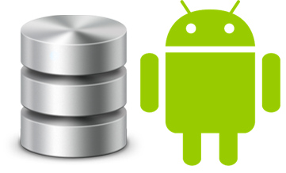
Libraries and Tools used
AppBlocking
UsageStatsManager
GoogleFit Api
Todo
Android Room Database
Material Progressbar for timer
Location Reminder
Google GPS API
Naver Searchplace API
ODSay API
Daimajia SwipeLayout

Slide 7
Homework mode
& To-do list
Feature

Slide 8
From the last presentation To-Do List & Homework Mode
Things need to be done
Stable Timer
Send Notification 3 minutes prior to timer ends with vibration ( 4 seconds after timer starts in Demo version )
Make alarm go off as timer ends
Use motion data to turn off the alarm
Expected technical challenges
Keeping the timer going as the app goes to the background
Detecting user motions (especially walking )
Making sensors alive only when they are needed

Slide 9
To-Do List & Homework Mode Challenges
Challenges
Working with time in android was very cumbersome task(Timer, Alarm)
Controlling the sensor object (making it alive only when it is needed) was also cumbersome
Notification has been quite easy compared to other parts
How were the challenges handled?
Stable Timer & Alarm : Accomplished by using shared preferences and properly catching android activity lifecycle
Sensor : It’s only alive when it’s needed ( shaking, walking mission ) by registering / unregistering at appropriate timing & Checking if the sensor object is already instantiated

Slide 10
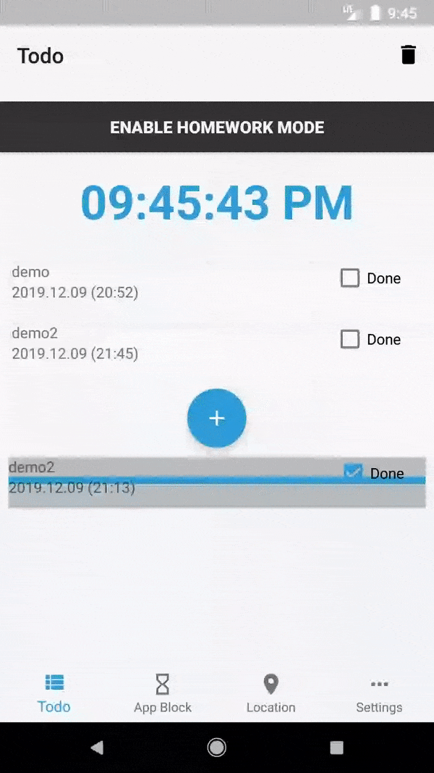
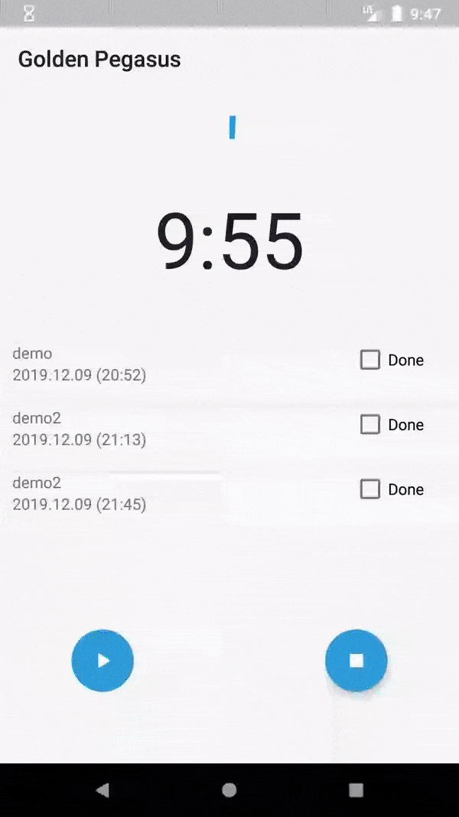
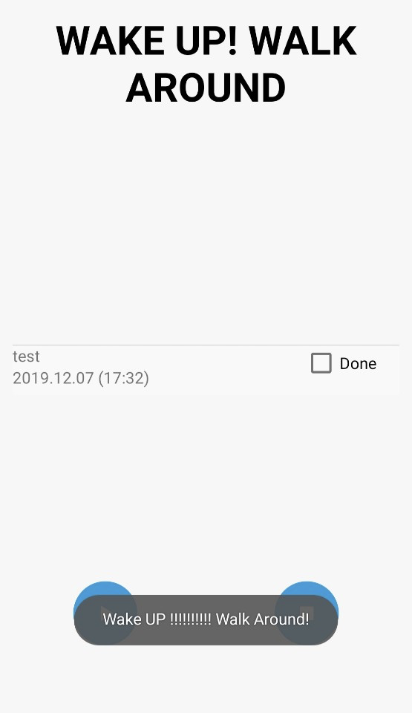
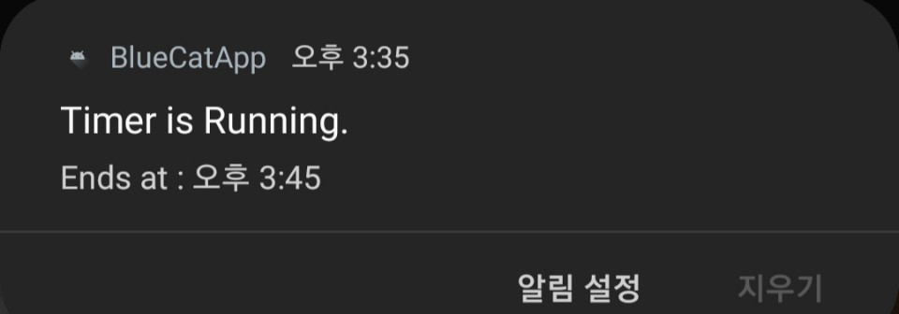
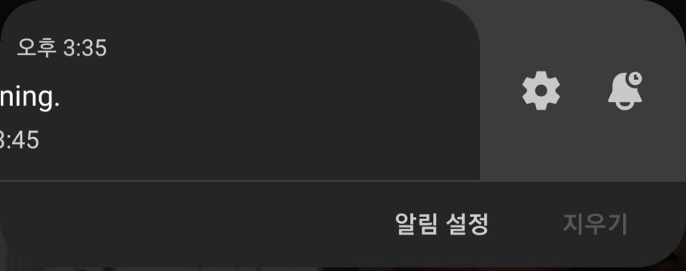
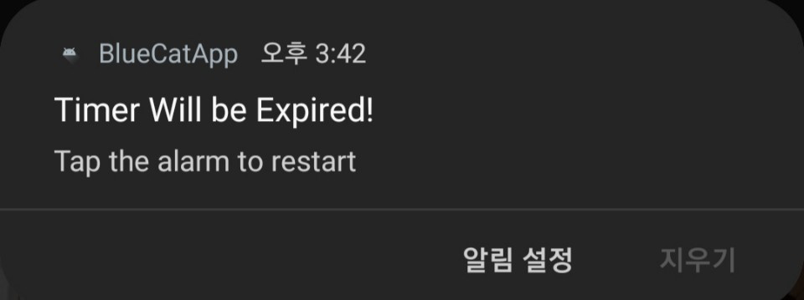
To-Do List & Homework Mode DEMO
<Running>
(Vibrates until the mission is completed & Cannot terminate even if the user turns off the app )
<Pre-Notification>

Slide 11
Smart App-Blocking
Feature

Slide 12
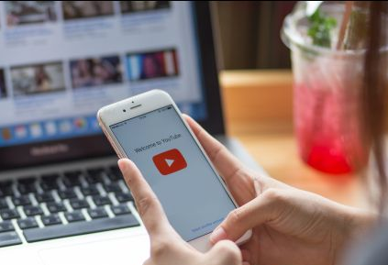





App Blocking Use Case
Without GoldenPegasus
With GoldenPegasus
Notes:
User has work to do but is spending too much time on Youtube
User turns on App blocking function on BlueCat
User procrastinates and continues watching Youtube videos
After 30 mins (default), the BlueCat app blocks Youtube and sends user to app blocking screen
User stops procrastinating and gets back to work
When user is finished with work or wants to take a break, can watch YouTube again.
If user continues to watch Youtube, app is blocked again after 30 mins

Slide 13
App Blocking Key Technical Challenges
Challenges
Solutions
Improving accuracy of pedometer feature
GoogleFit API step counter
LINEAR_ACCELERATION sensor as fallback
Update fragment view on data change
notifyDataChanged to update values in adapter
Algorithms for multiple app blocking features
Different conditions to trigger each case (Differentiate HW mode and regular app blocking)

Slide 14
App Blocking Feature Implementations
Notifications prior to app block
Pedometer feature
Walk set amount of steps to unblock app
Smart blocking feature
Detects procrastination and blocks accordingly
Setting to disable feature
Send toast notification 5 mins and 1 min before blocking
GoogleFit and Accelerometer sensor to detect step count
Unblock when both timer and step counts completed
Strict mode for Smart Blocking
Toggle for features disabled when active app block exists

Slide 15
Location Reminders
Feature

Slide 16
From the last presentation Location Reminder
Things needed to be done
Gamification
Alarm or Notification
Multiple test cases
Various settings
Improve UI
Optimize power consumption
How it was conducted
Implemented gamification
Implemented both
Tested a variety of cases
Implemented various settings
Improved UI
Implemented simple heuristics

Slide 17
From the last presentation Location Reminder
Major bug fixes
Rapid double click issue -> lead to crash
Bad network connection issue -> handled through try-catch
12 o’clock issue -> Java time function mistake
Undesired values in database
Notes:
kind of redundant with technical challenge

Slide 18
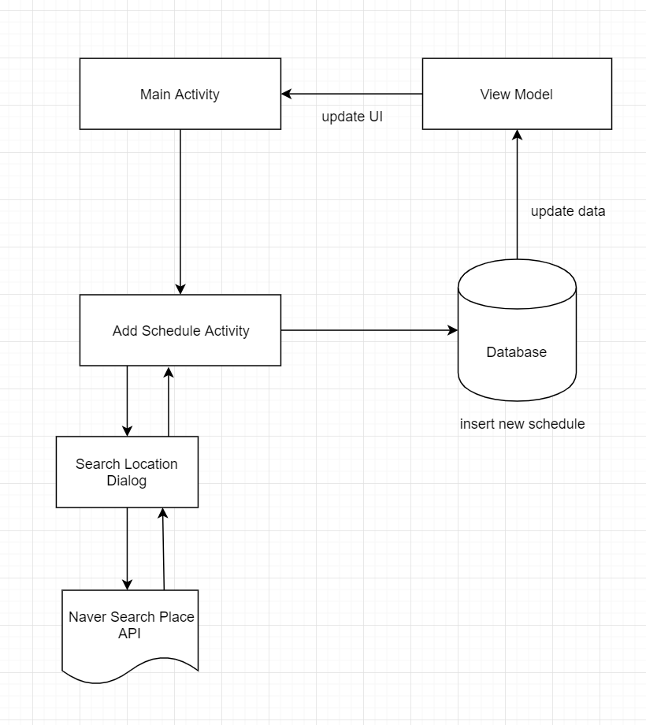
Location Reminder System Architecture

Slide 19
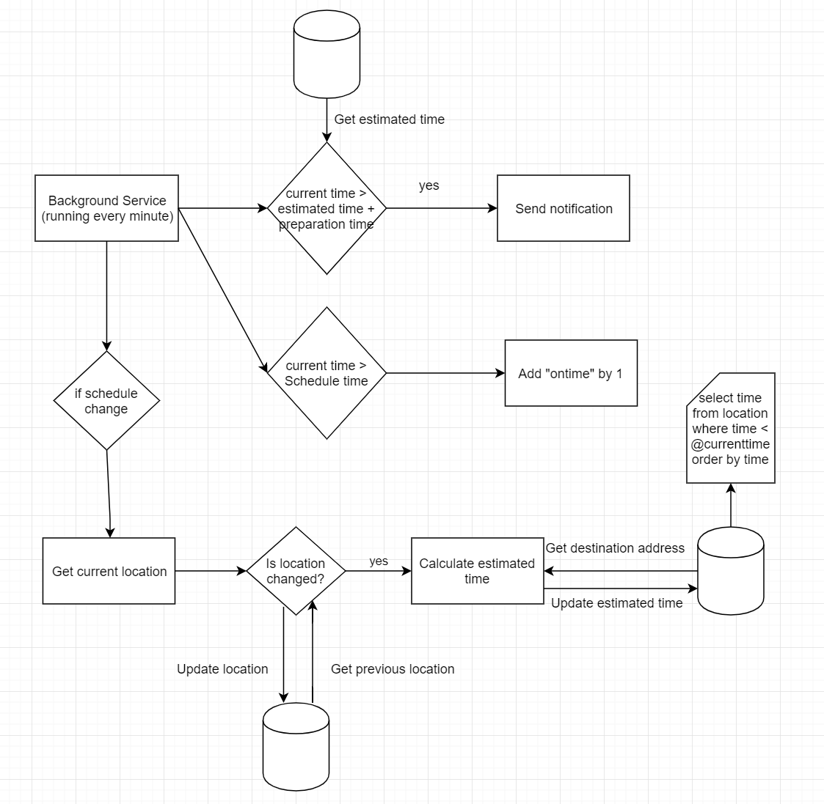
Location Reminder System Architecture

Slide 20
Location Reminder Technical Challenges and Solution
Challenges
Solutions
Lots of Boundary Cases
- Reboot phone after a few days
- Bad network connection
- Server error
- Sensor error
- UI issues (text overflow, etc)
Tested a variety of cases
- Implemented checkDate() function
- Implemented exception handler
- Displayed overflowed text with ellipsis
High battery drain
Minimized redundant operations
- Check location every one minute before 3 hours to the most imminent schedule
Used FusedLocationProviderClient

Slide 21
Location Reminder Evaluation
Conducted simple experiment for battery optimization
Under controlled environment
(Same duration, schedules and conditions)
Measured battery usage for three cases
Experiment Results
Without our App, consumed 3% of battery
With our App(w/o battery optimization), consumed 13%
With our App(with battery optimization), consumed 10%
It works ! (Optimization would work much better for test cases with sparse schedules)
Notes:
Experiment condition : Controlled condition
Duration - 5 hours, Schdules - Two schedues (t0+4 용산역, t0+5 신림역)
All of them in cellular mode(no wifi), didn’t touch phone just once an hour. conducted on same phone(Galaxy S9 Android 9)

Slide 22
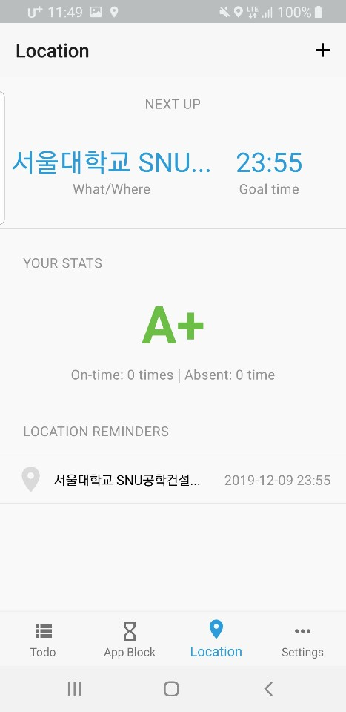
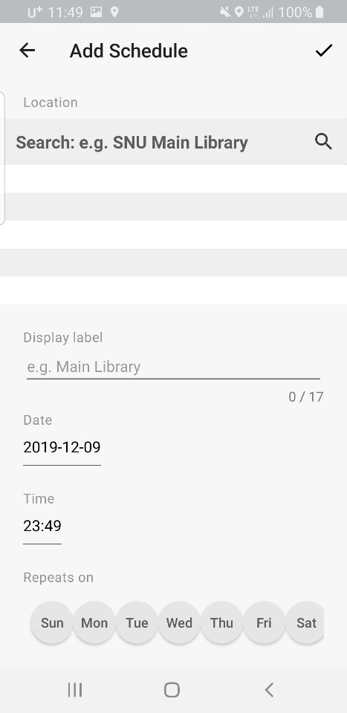
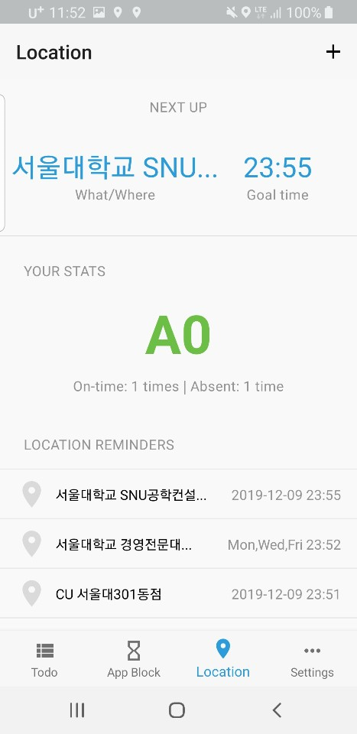
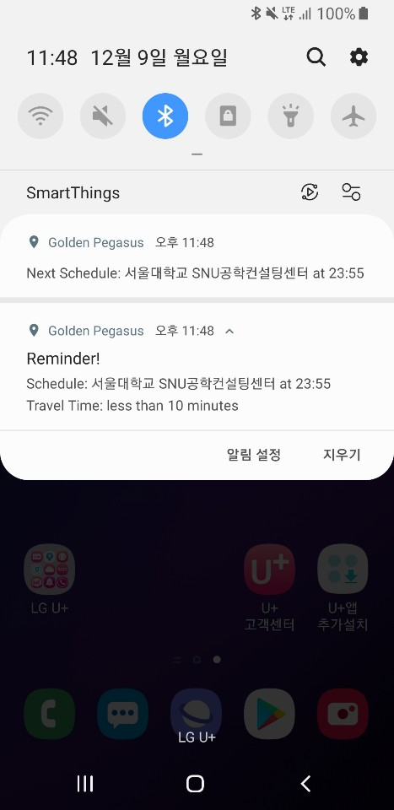
Location Reminder Demo
Notes:
Experiment condition : Controlled condition
Duration - 5 hours, Schdules - Two schedues (t0+4 용산역, t0+5 신림역)
All of them in cellular mode(no wifi), didn’t touch phone just once an hour. conducted on same phone(Galaxy S9 Android 9)

Slide 23
Project Management

Slide 24
Scope
Location Reminder
Complicated Gamification → Simple Gamification
Simplified for easy use
Keep estimated travel time internal → Show estimated time to user
Shows how long it takes to go to the destination through the notification
App Blocking
Advanced smart blocking algorithm → Simplified algorithm based on usage & app switching
Interactive UI (Swipe screen & selectable list items) → Simple layout, avoid over cluttering
Todo-List & HW mode
Sending Notifications if the user has tasks due soon → No notification for such tasks
Too much notifications from single app

Slide 25
Timeline
Iteration | Duration | Main Goal | Leader
1 | Oct 7 ~ Oct 13 | Initial planning, scheduling, mockups | Marita
2 | Oct 14 ~ Oct 21 | Learn Android and Kotlin, implement basic functionality | Jinyeong Kim
3 | Oct 22 ~ Nov 4 | Develop basic form into MVP | Seungwoo Jo
4 | Nov 5 ~ Nov 18 | Implement remaining | Rachel Gan
5 | Nov 19 ~ Dec 2 | Testing and debugging | YoungWoong Jun
6 | Dec 3 ~ Dec 9 | Finalize features, buffer, presentation | Marita

Slide 26
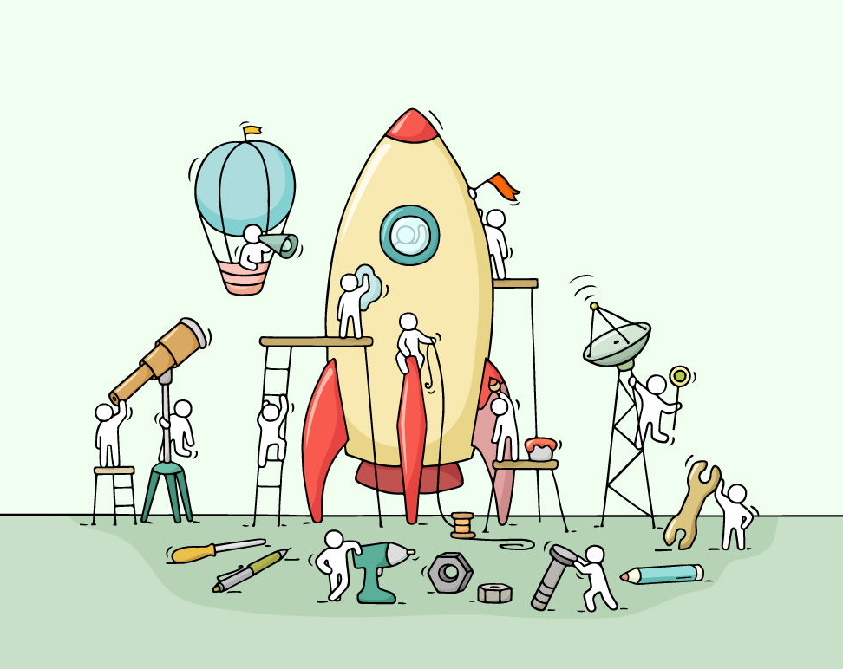
Roles and Contributions
Homework & Todo
Jin Yeong Kim
App Blocking
Rachel Gan, Sigrid Marita Kvamme
Location Reminders
Young Woong Jun, Seung Woo Jo

Slide 27
Lessons Learnt
(Obviously) No Plan Survives : Has been great opportunity to experience it.
Buffers are important: Always plan ahead in case of project deviations
Divide & Cooperate : Divided the team into small three groups based on the features and efficiently divided the tasks and cooperated when help was needed from each other.
Conducting a lot of feature tests is important

Slide 28
Conclusion

Slide 29
Project Schedule
Efforts
Weekly one hour meeting to catch up on project progress
Other than the Whole Project sheet, we used Github Issues to divide/specify the tasks into small chunks
But...Deviations
Most of the features took more time than expected to implement ( tracking app usage data, tracking location , stable timer…)
It was a great decision to have buffer week before the due date.
Lessons learned
(Obviously) No Plan Survives : Has been great opportunity to experiencing it.
Divide & Cooperate : Divided the team into small three groups based on the features and efficiently divided the tasks and cooperated when help was needed from each other.
Doing a lot of test is important
Notes:
Just made some comments on

